Slide 1
edubase Cloud
An Open-source Cloud Platform for Cloud Engineers
Nobukazu Yoshioka, Shigetoshi Yokoyama, Yoshionori Tanabe, and Shinichi Honiden
National Institute of Informatics
(Presenter) Shigetoshi Yokoyama: @jxta
Notes:
Thank you, Chris.
I am today’s presenter, Shigetoshi Yokoyama.
I would like to introduce our education cloud which is called edubase Cloud, very briefly and quickly.
This is an open source cloud platform for cloud engineers.
My talk starts from a sad story in Tokyo, last summer.

Slide 2
A sad story in Tokyo, , 2010 summer
There was a master students project called Beyohn in Tokyo Univ. which was developing auto-scale JVM clusters, like terracotta, on edubase Cloud.
(“Beyohn” is Onomatopoeia of Stretch in Japanese)
I have been an advisor of the project since May, 2010.
The sad story started at midnight of July 21st.
The project members are preparing data for a middle term report presentation on July 23rd.
And they are generating load and monitoring performance of a reference application, after setting up several auto-scale JVM clusters on edubase Cloud, like this.

Slide 3
An accident happened !
Grinder
Exam
Beyohn
Exam
Beyohn
Grinder
Exam
Beyohn
HAProxy
Exam
Beyohn
Exam
Beyohn
Terra
DB
Grinder
Exam
Beyohn
Grinder
Exam
Beyohn
Every instance in the cloud disappeared, gradually, within 10 min. Every member, including myself, saw it
from home and school. That was very chilly experience.
We had to survive the presentation session without any good performance data. Very sad.
Notes:
We used Grainder as load generator , HA_proxy as load balancer, and teracotta. We developed beyohn code for auto-scaling. Sample application was Examinator which is provided from terracotta.
(Click)

Slide 4
Which is better for our cloud engineer education?
Fewer accidents
More
accidents
Open source
PaaS/SaaS
Open source
PaaS/SaaS
versus
Commercial
IaaS
Open source
IaaS
Notes:
We can change to more stable IaaS, like Amazon Web Services for the
project. :->
Probably, we will have fewer accidents on it.
Which should I choose?

Slide 5
Our choice is “more accidents”
The bottom cause of the accident was a bug in the physical NIC driver.
(Of course, we had done many smoke tests before service launch. We also tried to re-produce similar accident by using Netperf and so on but it was tough to re-produce the incident, artificially.)
The algorithm in the cloud controller of eucalyptus had to be enhanced, as well.
The students participated to this trouble shooting process and learned cloud technologies, “accidentally.”
After the bug fix, the project went well and had a good
final presentation in Feb, 2011.
(Almost all members want to use edubase Cloud for other projects including their master thesis, now.
Another student studying technologies in IaaS layer.)
Notes:
Our choice at that time and current one is more accidents.
(Click)

Slide 6
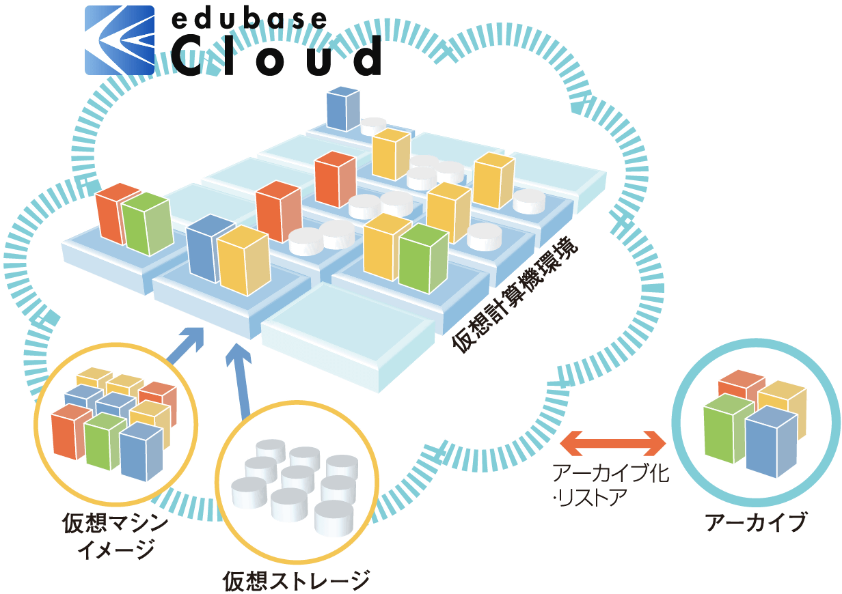

Motivation
Cloud Engineer Training Environment
Targeted cloud engineers | Requirements
Type1) Cloud application developers | R0: IaaS cloud
Type 2) Cloud developers | + R1: Customizable IaaS R2: Cloud interoperability R3: Monitoring physical resources
Mini clouds
（16 nodes × 10 sets
+ 8 nodes × 5 sets）
edubase Cloud architecture
Multiple clouds w/ services
(monitoring/archiving)
Open source-based
Open interface
① Customize
② Monitor
Clouds
External cloud
④ Interoperate
Archive/
restore
Archive files
Machine images
Virtual storage
③ Archive
Notes:
The sad story ends and the main story starts and should end 3 minutes or so.
edubase Cloud is a cloud engineer training environment.
We think there are two types cloud engineers to be trained.
The first one is cloud application developer and the other is cloud developer.
For training type 1 cloud engineers, IaaS cloud is good environment because it is actually application deployment . IaaS is request 0.
For training type 2 cloud engineers, there are other requirements like customizability, interoperability and physical resource monitoring.
In order to satisfy these requirements, edubase Cloud is based open source and interface. It also has multi-clouds architecture with the common archive service and monitoring service. I meant by multi-clouds that the cloud consists of separated 15 mini-clouds which have different end points.

Slide 7
Related Works
Customizability
(customizable layers)
edubase
Cloud
Including
cloud platform layer
ACCI
Only
upper layer of
cloud platform
AWS in Education
1
5
Versatility
# of application frameworks
ACCI: Academic Cloud Computing Initiative
AWS: Amazon Web Services
6
Notes:
The shows edubase Cloud position among similar education cloud activities.
It has more customizability and versatility in terms of application frameworks.

Slide 8
Demonstrations
Notes:
Today I can show you several demonstrations.

Slide 9
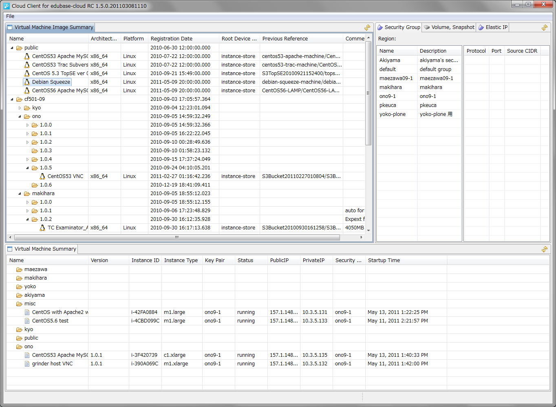
R0: IaaS Cloud
Eclipse base
cloud client
Machine image list
Security groups,
Snapshots, …
Instance list
Notes:
The first one is demonstration to show some edubase Cloud unique functionalities as IaaS.

Slide 10
R1: Customizable IaaS
Original
Hacked
Pre-executed
Machine image download from CLC
Machine image download from CLC
Run-instance
Pre-executed
Client
CLC
Machine image copy
Machine image copy
Run-instance
Credential setting
Credential setting
Pre-executed
CC
Ephemeral disk setting
Ephemeral disk setting
Run-instance
Pre-executed
SWAP area setting
SWAP area setting
CLC : Cloud Controller
CC : Cluster Controller
NC : Node Controller
Xen virCreateDomainLinux call
Xen virCreateDomainLinux call
NC
Multiple instance launching time
Multiple instance launching time
Launching time (Sec)
Launching time (Sec)
Notes:
The second one is to show you one example of IaaS customization. Hacking to eucalyptus for speeding up instance launching time.

Slide 11
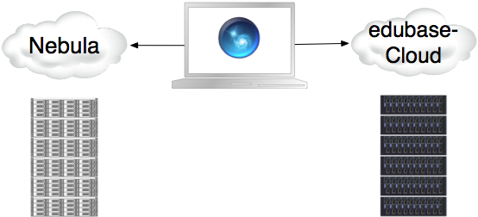
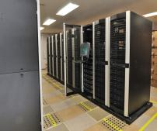
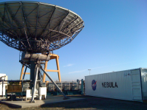
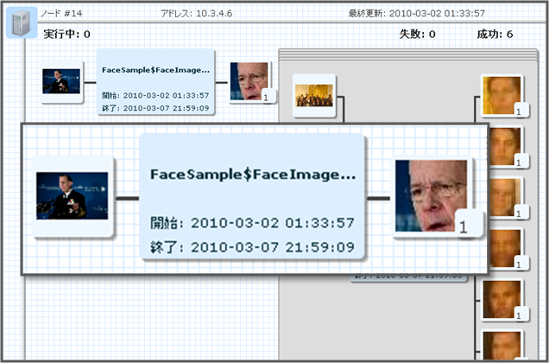
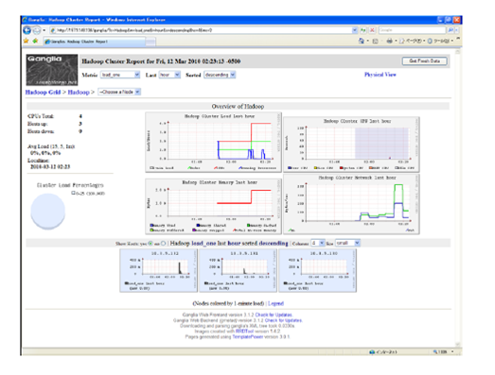
R2: Cloud Interoperability
Collaboration between NII and NASA AMES (-2010.6)
Open interface
Program cooperation
Program portability
Open data
Interoperable Data
Open source
Quality with community
@ Mountain view
@ Chiba
NII application on Nebula:
Hadoop system developed at NII
NASA Application on edubase Cloud:
WiorldWide Telescope
Notes:
The third one is interoperability with other clouds. For example, we developed a tool to convert machine images between AWS and edubase Cloud.
We had also a project with NASA AMES to show interoperability between NASA Nebula cloud and edubase Cloud.

Slide 12
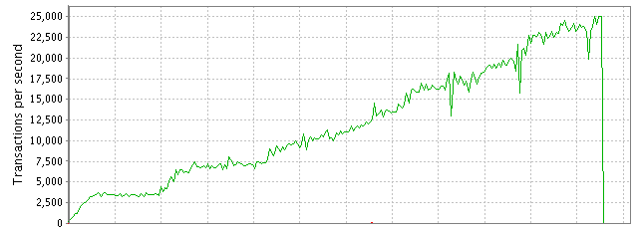
R3: Monitoring
Project-based learning project: “Beyohn” (-2011.2)
Users
Load balancer
Automatic scale out
Automatic Scaling middleware
for Java applications
Beyohn can be deployed with
JVMs clustered by terracotta
Beyohn project used the cloud as
development environment,
load generation, performance test
environment and production environment
Web service
Web service
Web Service
cache
Beyohn
cache
Beyohn
cache
Beyohn
Cache server
Data
DB
Auto scaling
Notes:
The last one is Beyohn project which I referred in the introduction.
I would like to show you this first because I explained some of it, already.
Beyohn is automatic scaling middleware for java applications.
It monitor cpu load and other system metrics and decide scaling timing
accoding to pre-defined conditions.
In the demo, the condition is to launch new instance if the cpu usage exceed 60%.
This is the demonstration.
(Video)
I would like to conclude this talk.

Slide 13
Federated open clouds test-bed for academic communities, together.
Conclusion
Open Cloud
(Kyushu Univ.)
Open Cloud
(NII)
Open Cloud
(Hokkaido Univ.)
・・・
・・・
Hi-speed network (SINET)
yoko@nii.ac.jp / @jxta
http://grace-center.jp/en/prj_educloud.html
Notes:
I would like extend out mini-clouds globally and prepare better and realistic cloud education environment.
I think that can be said as federated open cloudｓ test-bed.
I am planning to develop a cloud for NII researchers using OpenStack, this year.
After that I want to merge education cloud and this cloud as an academic cloud.
I hope there is good migration from cloud to cloud.b
However, we have
(Click)
Please contact me, if you have any interest to this activity.
Thank you.

